Slide 1
The Math Behind the Presidential Election
Brittany Alexander, Dr. Leif Ellingson

Slide 2
My project
My project is based on the work of Nate Silver who predicted the outcome of the 2008 election with 98% accuracy, and 100% accuracy in 2012.
Nate Silver, like most political science statisticians is not an academic researcher. He didn’t disclose much about his model and didn’t form a final prediction until the day of the election
The first step was testing a theory of using the results of previous states to predict the primary outcome in future states.
Now I am trying to test the theory that you can use Bayesian Statistics to predict a presidential election with higher accuracy than a simple average of polls

Slide 3
Why Bayesian Statistics?
Bayesian Statistics considers likelihood and allows the inclusion of outside data while still using data from that state
It provides a level of choice in a prior to include information not reflected in the polls or results
It was something that I could study given that I had a limited knowledge of statistics as an undergraduate student
It appeared to work for Nate Silver in 2008 and 2012.

Slide 4
Why my project matters
People who predict elections like Nate Silver don’t always have formal training in Statistics
Most of the time information on how the prediction is formed is not revealed
In Academia, election statistics are usually studied after instead of during the process
Most statistics in political science research are basic
My goal was to approach my project scientifically

Slide 5
What I am doing
My project really has two parts: the predictions and the blog.
I have a blog where I write about my feelings about the election and how math and sometimes economics are playing a role.
My predictions are final when submitted
I don’t edit any of my posts
I use a blogger account so that there is a third party record of my information
I disclose my personal opinions
Every prediction is made at least 48 Hours in advance. I disclose the mean, standard deviation and confidence interval

Slide 6
Methodology for the Nomination Process
I used excel to make predictions
After Iowa and New Hampshire I used previous results from elections as my prior
This is much more difficult than predicting a general election because there are multiple candidates and complicated rules for assigning delegates
I used a normal distribution to simulate likelihood
All elections were called at least 48 hours in advance
So far I have not been able to find a good comparison to judge accuracy

Slide 7
Methodology for the Nomination Process Continued
I had clear cut rules on when and how I would predict set before any votes were cast
I tried to balance making decisions on opinion based and data based factors
After Super Tuesday I realized that there were flaws in how my model handled candidate dropouts and the limited availability of states for the prior
I believe a better model would be to create a prior based on exit poll data to create a better fitting sample

Slide 8
Results for the Nomination Process
I had 79.6% accuracy
I used second choice data to normalize the probabilities
This overestimated the more traditional candidates like Cruz and Rubio, and caused an underestimation of Trump
The second choice data suggested that Trump would not gain supporter over the process but this was not the case
Trump did not have any of the normal indicators for a nominee (campaign funding, endorsements, support of media outlets)
Further testing is needed to see how this kind of model would work in other years

Slide 9
Methodology for the Presidential Election
I am using a Gaussian conjugate analysis on poll data
My prior is national polls for swing states, Texas/Nebraska polls for Red States, and New York/California Polls for Blue States
I am using Anaconda (a python platform) with Scipy and Numpy to make my calculations
I download CSV of poll data from Pollster , and “clean” them to make the program able to read it.
The results are added to a file.
Only poll results taken after July 1st, 2016 are considered. July 1st was chosen because it was after the candidates were decided and media coverage of the general election was beginning

Slide 10
Methodology for the Presidential Election Continued
Priors are chosen based on the political stance of a state (Red vs Blue), and the demographics
My Priors are Nebraska for Midwest Red States, Texas for the Red south states, New York for northern blue states, California for western blue states, and National Polls for swing states
For states that serve as a prior for their category data from a similar state will serve as the prior
My predictions go final on November 5th at Midnight
Information on predictions from Five Thirty Eight, 270 to Win, and Princeton Election Consortium will be pulled on the 6th to allow for a better comparison of accuracy
If something changes after Saturday but before Tuesday I may add on update

Slide 11
What I consider Swing State
My definition of a Swing State is any state that the outcome was hard to determine at any point of the process, and has a reasonable chance of a 2 or more outcomes
My swing states are: Arizona, Colorado, Florida, Iowa, Nevada, New Hampshire, North Carolina, Ohio, Pennsylvania, Utah , Virginia, Wisconsin

Slide 12
What I learned so far
Previous states are fairly good predictors of future states in a sequential primary, but further study is needed with a more complicated model
Donald Trump doesn’t fit the traditional candidate mold. His supporters are incredibly enthusiastic and I plan to break down how this happened by breaking down the data from both the primary and general election because it could change how future elections work
Methods to find and produce better fitting priors should be studied
Advanced Statistical methods aren’t used in political science research statistics. I plan to get my Ph.D. in Statistics and focus on political science statistics in my career.

Slide 13
What will happen on November 8th?
Hillary Clinton will probably win the presidency decisively.
The senate is a tossup. I am not studying it in depth but the polls look like the majority could go either way.
General Election Turnout may not increase like the turnout in the nomination process, but the turnout could still be record breaking
Gary Johnson, may break 5% and the libertarian party may get major party status
There is the potential that this election may be hard to predict and my model and the model of others may not achieve 100% accuracy

Slide 14
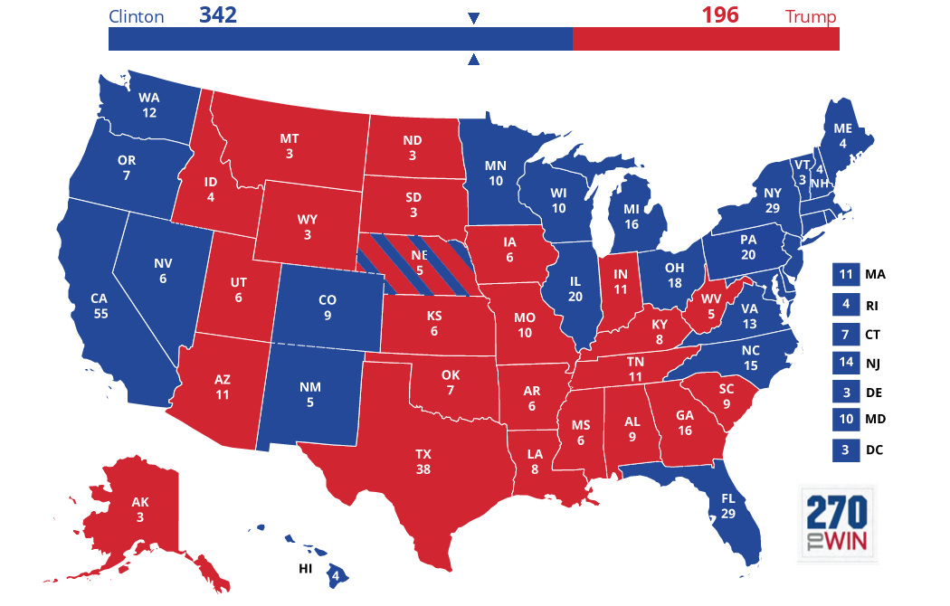
My current Projection

Slide 15
Looking Forward to 2020
Colorado may not be considered a swing state and may turn blue
Utah, Arizona, and other “red” states who were at one point at risk of swinging will probably be fine in 2020 assuming the Republican nominee is less controversial.
I plan to try to use more advanced methods to predict again

