Slide 1
The Math Behind the Presidential Election
By: Brittany Alexander, Dr. Leif Ellingson

Slide 2
What is Undergraduate Research?
Undergraduate Research is when an undergraduate student studies a question and conducts research by performing an experiment or otherwise collecting information
This research can be a side project of the mentor’s research or be independent

Slide 3
Why Undergraduate Research?
It’s interactive: You get to be involved in making decisions about what steps to take
It’s challenging: Often what you are researching is unknown or not well-understood.
You learn things that you wouldn’t necessarily learn in a classroom
What you discover could impact your field

Slide 4
My project
My project is based on the work of Nate Silver who predicted the outcome of the 2008 election with 98% accuracy, and 100% accuracy in 2012.
Nate Silver, like most political science statisticians is not an academic researcher. He didn’t disclose much about his model and didn’t form a final prediction until the day of the election
The first step was testing a theory if you could use the results of previous states to successfully predict the primary outcome in future states.
Now I am trying to test the theory that you can use Bayesian Statistics to predict a presidential election more accurately than a simple average of polls

Slide 5
What is Bayesian Statistics?
Bayesian Statistics is about finding the likelihood of a hypothesis given prior data
In the context of my project it basically creates a weighted average of the polls and adjusts for the likelihood of a poll based on the prior data.
Bayesian Statistics can be used for just about anything from finding defective products, to measuring the accuracy of medical tests.

Slide 6
How polls work
A company or sometimes a University contacts potential voters through phone interviews or the internet and screens them to get a scientific sample.
Questions are asked about candidate preference, general political ideology, and demographic information
The data is analyzed and a report is usually published to the public. The reports usually include a summary of the demographics , and a breakdown of results of every question.
Polling Agencies have multiple mechanisms in place to protect the integrity of the poll. Poll fraud is rare with reputable agencies.

Slide 7
How to look at a poll
Since polls are from a small sample they are not 100% accurate and you have to account for variation
The margin of error helps to account for this variation but the true mean of the entire population may not be inside this interval
If the lead of a candidate is within the margin of error the race is probably to close to call based on the only information from that poll
However there are ways to make a call about leads in the margin of error.

Slide 8
Why my project matters
  Candidates frequently misquote or misinterpret statistics or polls and the average voter may not know what is going on
  Journalists can also continue this by promoting myths that a candidate is winning when the poll is within the margin of error
  People who predict elections like Nate Silver don’t always have formal training in Statistics
  In Academia, election statistics is usually studied after instead of during the process
  Most statistics in political science research are basic

Slide 9
Why Statistics is the biggest issue of a campaign
Most statements made by candidates have some form of a statistic in them
But a candidate can make and use bad statistics to mislead voters
Bad statistics could be totally false and made up or they can be misleading or cherry-picked to prove a point
This is a bipartisan issue. I have seen every candidate do this.
Most of the time the data talked about is public and you can find the facts for yourself
Statistics if done ethically are helpful in decision making

Slide 10
What I am doing
My project really has two parts: the predictions and the blog.
I have a blog where I write about my feelings about the election and how math and sometimes economics are playing a role.
My predictions are final when submitted and are submitted at least 72 hours before the polls close.
I don’t edit any of my posts
I use a blogger account so that there is a third party record of my information
I disclose my personal opinions
2016usaelectionpredictions.blogspot.com

Slide 11
How I make predictions
First I try to understand the political dynamic in all the states.
I also research rules of voting in the states.
For smaller states like Montana and Rhode Island poll data is limited
To help fix this problem I use poll results from states that have similar characteristics and more information
For example to predict Rhode Island I substitute in data from New York.
In the nomination process I used actual voting results as a data source
For the general election I am using poll data from states with lots of poll data

Slide 12
What I learned so far
Previous states are fairly good predictors of future states in a sequential primary, but further study is needed with a more complicated model
I achieved 80% accuracy in predicting bound delegates to the GOP convention
Delegates are really hard to predict because they are awarded with complicated rules
Donald Trump doesn’t appear fit the traditional candidate mold. His supporters are incredibly enthusiastic and I plan to break down how he got nomination by breaking down the data from both the primary and general election because it could change how future elections work
Advanced Statistical methods aren’t regularly used in political science statistics. I plan to get my Ph.D. in Statistics and focus on political science statistics in my career.

Slide 13
What will happen on November 8th?
My model shows that Hillary Clinton will probably win the presidency decisively but there a small chance that Trump will win
I personally am writing in a conservative candidate
The senate is a tossup
General election turnout may not increase like the turnout in the nomination process.
Gary Johnson, may break 5% and the libertarian party may get major party status

Slide 14
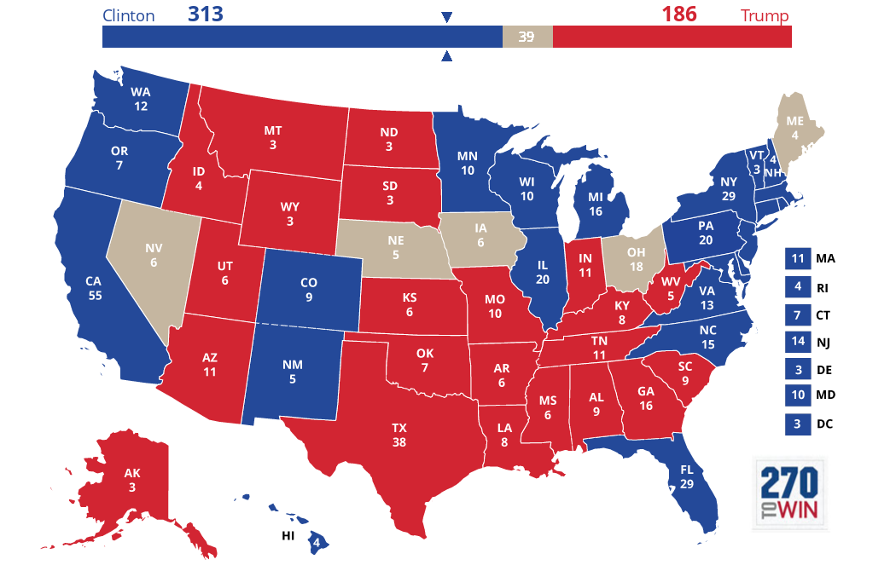
My current Projection 10/21

Slide 15
Is Texas a swing state?
Out of 17 polls since August Clinton was ahead only once by 1 point
11 of those showed a Trump lead outside of the margin of error
5 Polls had a Trump lead inside the margin of error, but most of the time the lead was almost bigger than the margin of error
Multiple reputable organizations like Five Thirty Eight and 270 to Win show a Trump victory in Texas.
Clinton may have a larger share of the votes than most other democratic candidates since 1980

Slide 16
Can Polls be Falsified?
The polling organizations used by the major news agencies have good track records
In this election only one poll from a reputable agency has been under scrutiny
The poll is question was a Wall Street Journal and NBC National Poll
A preliminary report was released while data was still being collected on the day of the Vice Presidential Debate
Since the data was leaked early it may have affected the later interviews in the poll
However the data itself was not fraudulent

Slide 17
Can Polls be falsified?
Most polling agencies have numerous safeguards to protect the integrity of the poll
The news organization itself who orders a poll doesn’t really have any effect on the poll
Phone Interviews are usually recorded
Internet poll data is usually protected from editing
The respondents are screened to help get an accurate sample
Because of these safeguards polls are normally done ethically and have scientifically sound results

Slide 18
Resources to Understand the Role of Statistics in the Election Process
My Blog: 2016usaelectionpredictions.blogspot.com My final predictions will be posted on 11/5/16.
Washington Post Fact Checker – Fact checks statements made by candidates https://www.washingtonpost.com/graphics/politics/2016-election/fact-checker/
Fivethirtyeight.com – Run by Nate Silver, and provides information on how statistics are playing a role
270towin.com – Run by the University of Virginia Center for Politics , contains information on House, Senate and Governors Races
fec.gov – Federal Election Commission website with information on results, campaign finance and election laws

Slide 19
Looking Forward to 2020
Colorado may not be considered a swing state and may turn blue
Utah, Arizona, and other “red” states who were at one point at risk of swinging will probably be fine in 2020 assuming the Republican nominee is less controversial.
Clinton may have to fight for a second term because she has a low favorability rating right now
It would probably be better if the Republican Party and Democratic Party had fewer candidates in the nomination process

Slide 20
Questions?

